Slide 1
Digital Music Store Analysis
PostgreSql

Slide 2
Overview
The Digital Music Store Analysis project is a comprehensive exploration of database management and data analysis skills applied to the digital music industry. It encompasses the design of a relational database schema tailored for a digital music store, the implementation of SQL queries to extract meaningful
insights from the database, and the generation of reports and recommendations based on analytical findings.
Key Components:
Database Design
Data Import and Manipulation SQL Queries and Analysis Reporting and Visualization

Slide 3
Skills Demonstrated:
Database Design
SQL Querying
Data Import and Manipulation
Data Analysis and Interpretation
Report Generation and Presentation
Critical Thinking and Problem-Solving in Business Contexts
Outcome and Impact:
Through this project, proficiency in database management, SQL querying, data analysis, and potentially data visualization is demonstrated. The insights gained from the analysis contribute to informed decision-making within the digital music store environment, Identifying areas for improvement in sales strategies, inventory management, and customer engagement.

Slide 4
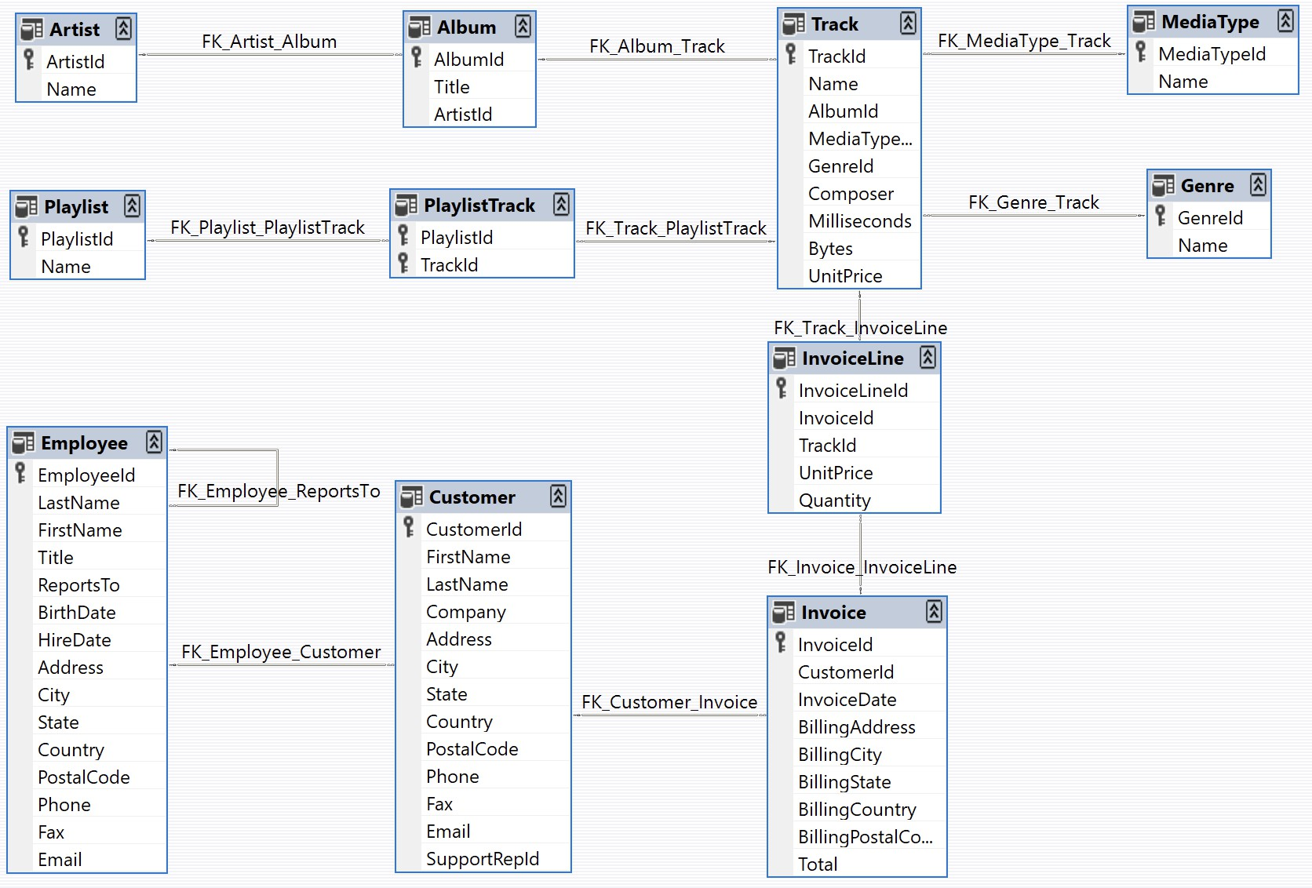
Schema

Slide 5

Q) Find the employee who has supported the most no of customers. Display the employee name and designation

Slide 6
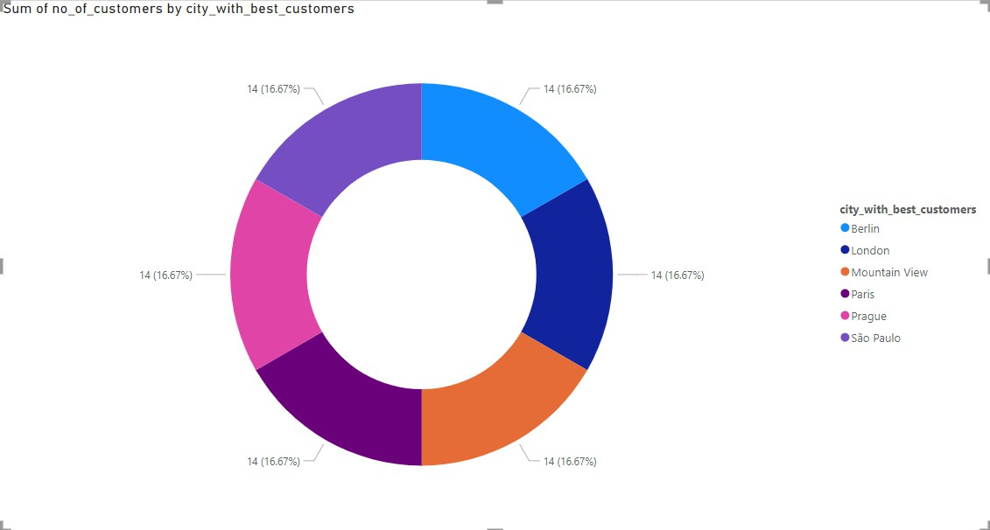
Q) Which city corresponds to the best customers?

Slide 7

Q) Find the artist who has contributed with the maximum no of songs Display the artist name and the no of albums.

Slide 8

Q) Name the best customer (customer who spent the most money).

Slide 9
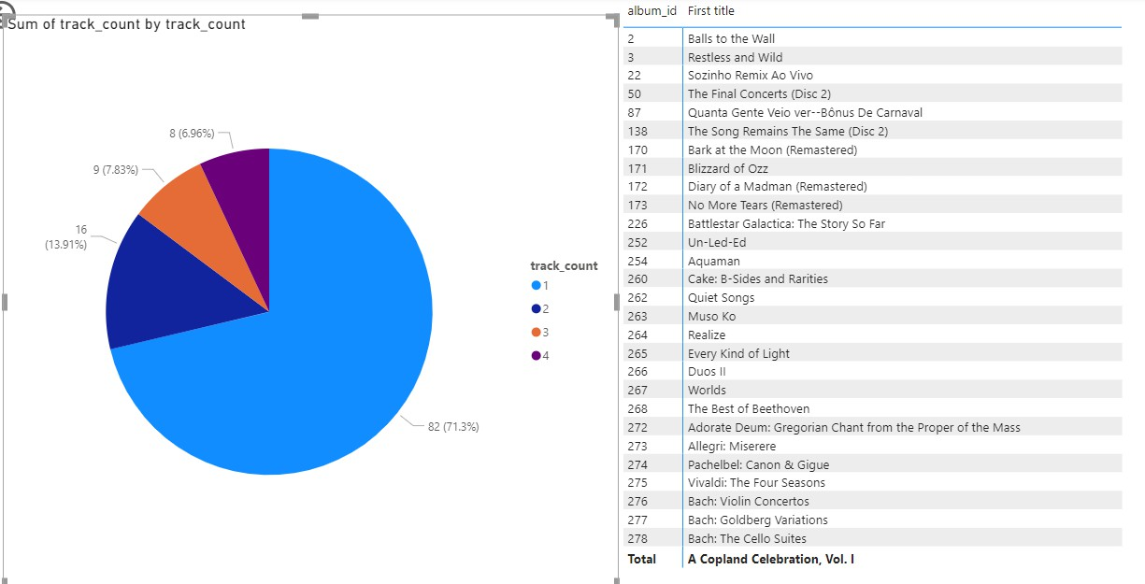
Q) Identify all the albums who have less then 5 track under them.

Slide 10

Q) Suppose you want to host a rock concert in a city and want to know which location should host it.

Slide 11
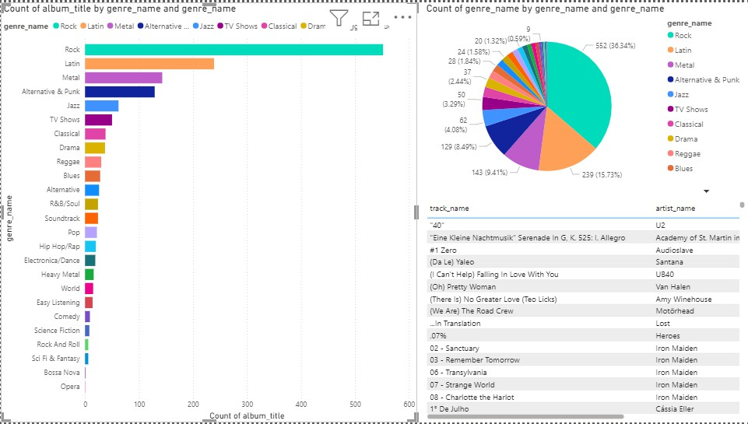
Q) Display the track, album, artist and the genre for all tracks which are not purchased.

Slide 12
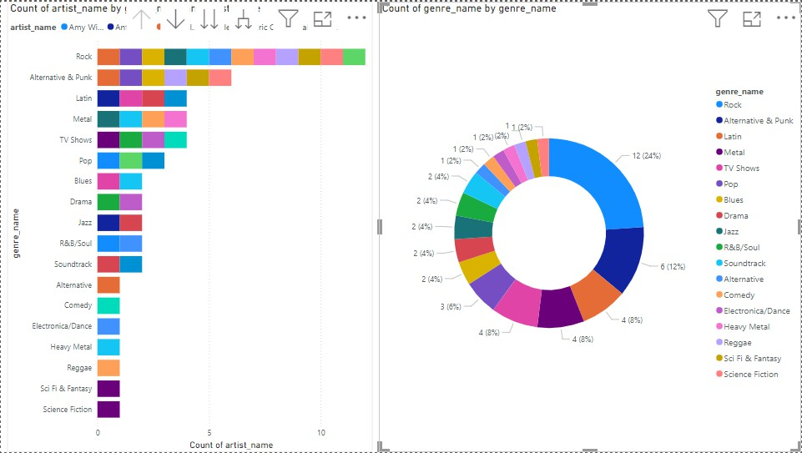
Q) Find artist who have performed in multiple genres. Diplay the aritst name and the genre.

Slide 13
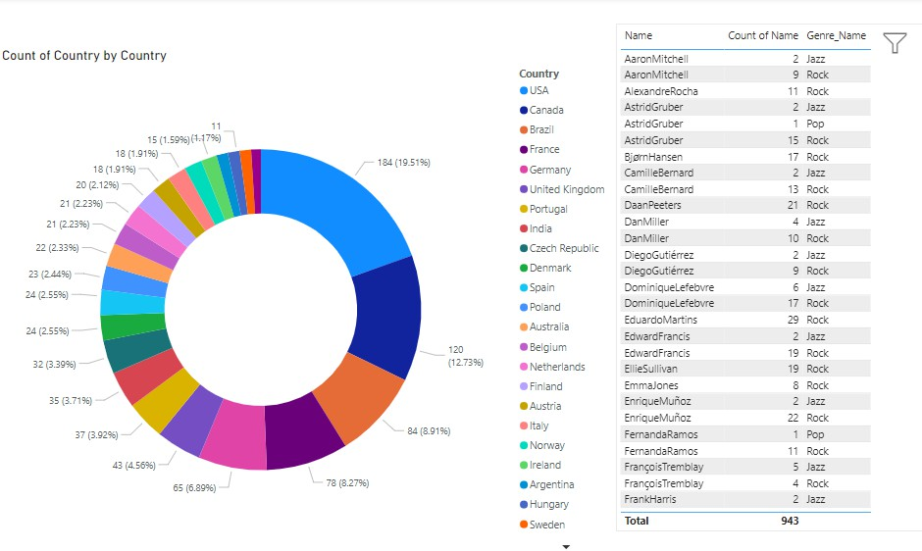
Query) Display name, country of all listeners who love Jazz, Rock and Pop music.

Slide 14
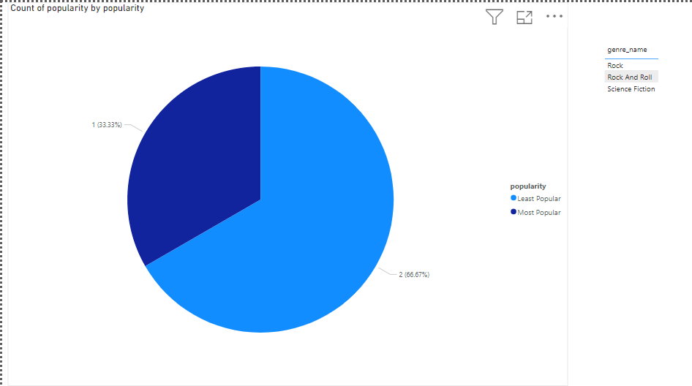
Q) Which is the most popular and least popular genre? (Popularity is defined based on how many times it has been purchased.)

Slide 15
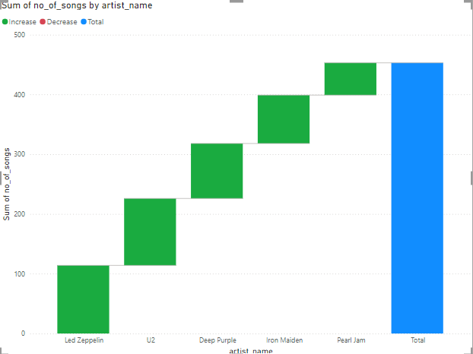
Q) Identify the 5 most popular artist for the most popular genre. Display the artist name along with the no of songs. (Popularity is defined based on how many songs an artist has performed in for the particular genre.)

Slide 16
Conclusion :
Based on the analysis of the customers and sales in the PostgreSQL digital music store, it was observed that certain customer segments are more likely to make high-value purchases, indicating potential opportunities for targeted marketing or promotions. Additionally, sales performance may be influenced by factors such as the timing of promotional activities, customer acquisition channels, and product preferences. These insights can inform strategic decisions to optimize sales and customer engagement.

